Slide 1

AGE AND GENDER PREDICTION
Team Members:
ANUBAMA G
HARITHAA G
JAVAJI SOWJANYA
KARPAGATHARENI S
Guided By:
Ms. J. Keerthika,
Assistant Professor, Dept. of CSE

Slide 2
Outline
Problem Statement
Abstract
Objective
Hardware Specification
Software Specification
Features
System diagram
Modules
Conclusion

Slide 3
PROBLEM STATEMENT
In Many Applications we might need to check the age of a person to provide contents based on that.. And also gender should be predicted to give exact suggestions for the user.
We humans are not able to predict the age of a person accurately by simply seeing with our eyes also it was difficult to predict Gender because some actors have potrayed the role of opposite gender in movies.

Slide 4
ABSTRACT
Age and gender predictions of unfiltered faces classify unconstrained real-world facial images into predefined age and gender.
Significant improvements have been made in this research area due to its usefulness in intelligent real-world applications. However, the traditional methods on the unfiltered benchmarks show their incompetency to handle large degrees of variations in those unconstrained images.
More recently, Convolutional Neural Networks (CNNs) based methods have been extensively used for classification tasks due to their excellent performance in facial analysis.
In this work, we proposed a CNN approach, to achieve robust age group and gender classification of unfiltered real-world faces.

Slide 5
OBJECTIVE
‘Gender and Age Prediction’ is a machine learning project based on computer visioning. Through this Project, you can learn the practical application of CNN i.e, the convolutional neural networks.
It’s a very practical project as you will create a model that can detect any human being’s age & gender through analyses of single face detection via an image. So, with this gender classification in a man or a woman can be classified.
Our solution is able to classify images in different lighting conditions and different illumination conditions and predict the exact age and gender

Slide 6
HARDWARE SPECIFICATION
PROCESSOR: i3 processor based computer or higher memory : 4 GB
PROCESSOR SPEED : 1.5 GHZ
SOFTWARE SPECIFICATION
PYTHON VERSION: python 3.8.10
OPERATING SYSTEM : windows 7 or higher versions
PYCHARM : Integrated development environment
LANGUAGE : Python

Slide 7
FEATURES
Our System will accept face images with spectacles and images of little babies who are less than 5 years.
Using age and gender detection we can easily predict the age and gender of a person and this can be embedded with any kinds of apps.. Like shopping apps , social media to limit the users according to their age
It can also be embedded with software systems in theme parks, to segregate the customers based on age for different rides.

Slide 8
SYSTEM DIAGRAM

Slide 9
WEBSITE
If face is present
FACE AREA DETECTION
INPUT IMAGE
If no face is present
PRE PROCESS FACE AREA
NO FACE DETECTED
CHECKING FOR NEXT FRAME
FEATURE EXTRACTION
PARAMETER CALCULATION
CLASSIFICATION
VERIFICATION
OUTPUT

Slide 10
MODULES
Uploading Image in the Website
Face Detection and pre processing
Feature Extraction and Classification
Age and Gender Prediction

Slide 11
MODULE 1: UPLOADING IMAGE IN THE WEBSITE
Input image is the image intended to test with the age and gender classifier.
User can input any type of image format like .jpg, .png, .tiff, and .bmp.

Slide 12
MODULE 2: FACE DETECTION & PRE PROCESSING
First phase will proceed to check whether the given input image contains a face image or not.
Algorithms will print no face detected if there was not any face area in the given input image.
If facial images are detected, the classifier will identify the face areas from the images and create a separate image per every face in the input image.
Classifier has been trained with a sufficient number of frontal, nearly frontal, rotated faces from 0 to 45 degrees and non face images.

Slide 13
CONTD…
Detected face images are pre-processed to standardize the face images by converting them to image format.
Images used in the experiment are in different conditions such as presence of noisy data, different lighting conditions and different intensity levels.
Thus, detected face images need to undergo a preprocessing step before forwarding to the classification stage for predicting gender and age.

Slide 14
MODULE 3: FEATURE EXTRACTION & CLASSIFICATION
The two-level CNN architecture includes feature extraction and classification itself.
The feature extraction extracts feature corresponding to age and gender , while the classification classifies the face images to the correct age group and gender.
Particularly, we address the large variations in the unfiltered real-world faces with a robust image preprocessing algorithm that prepares and processes those faces before being fed into the CNN model.
Classification is done using Artificial Neural Networks according to the different shape and texture variations of wrinkles on face images. The system can categorize and diagnose text sources automatically with a sensitivity and specificity of age and gender with unknown testing data.

Slide 15
MODULE 4: AGE AND GENDER PREDICTION
We will load the gender weight file and model file into the network.
After that gender will be predicted for the respective image
We will load the age weight file and model file into the network.
After that age will be predicted for the respective image

Slide 16
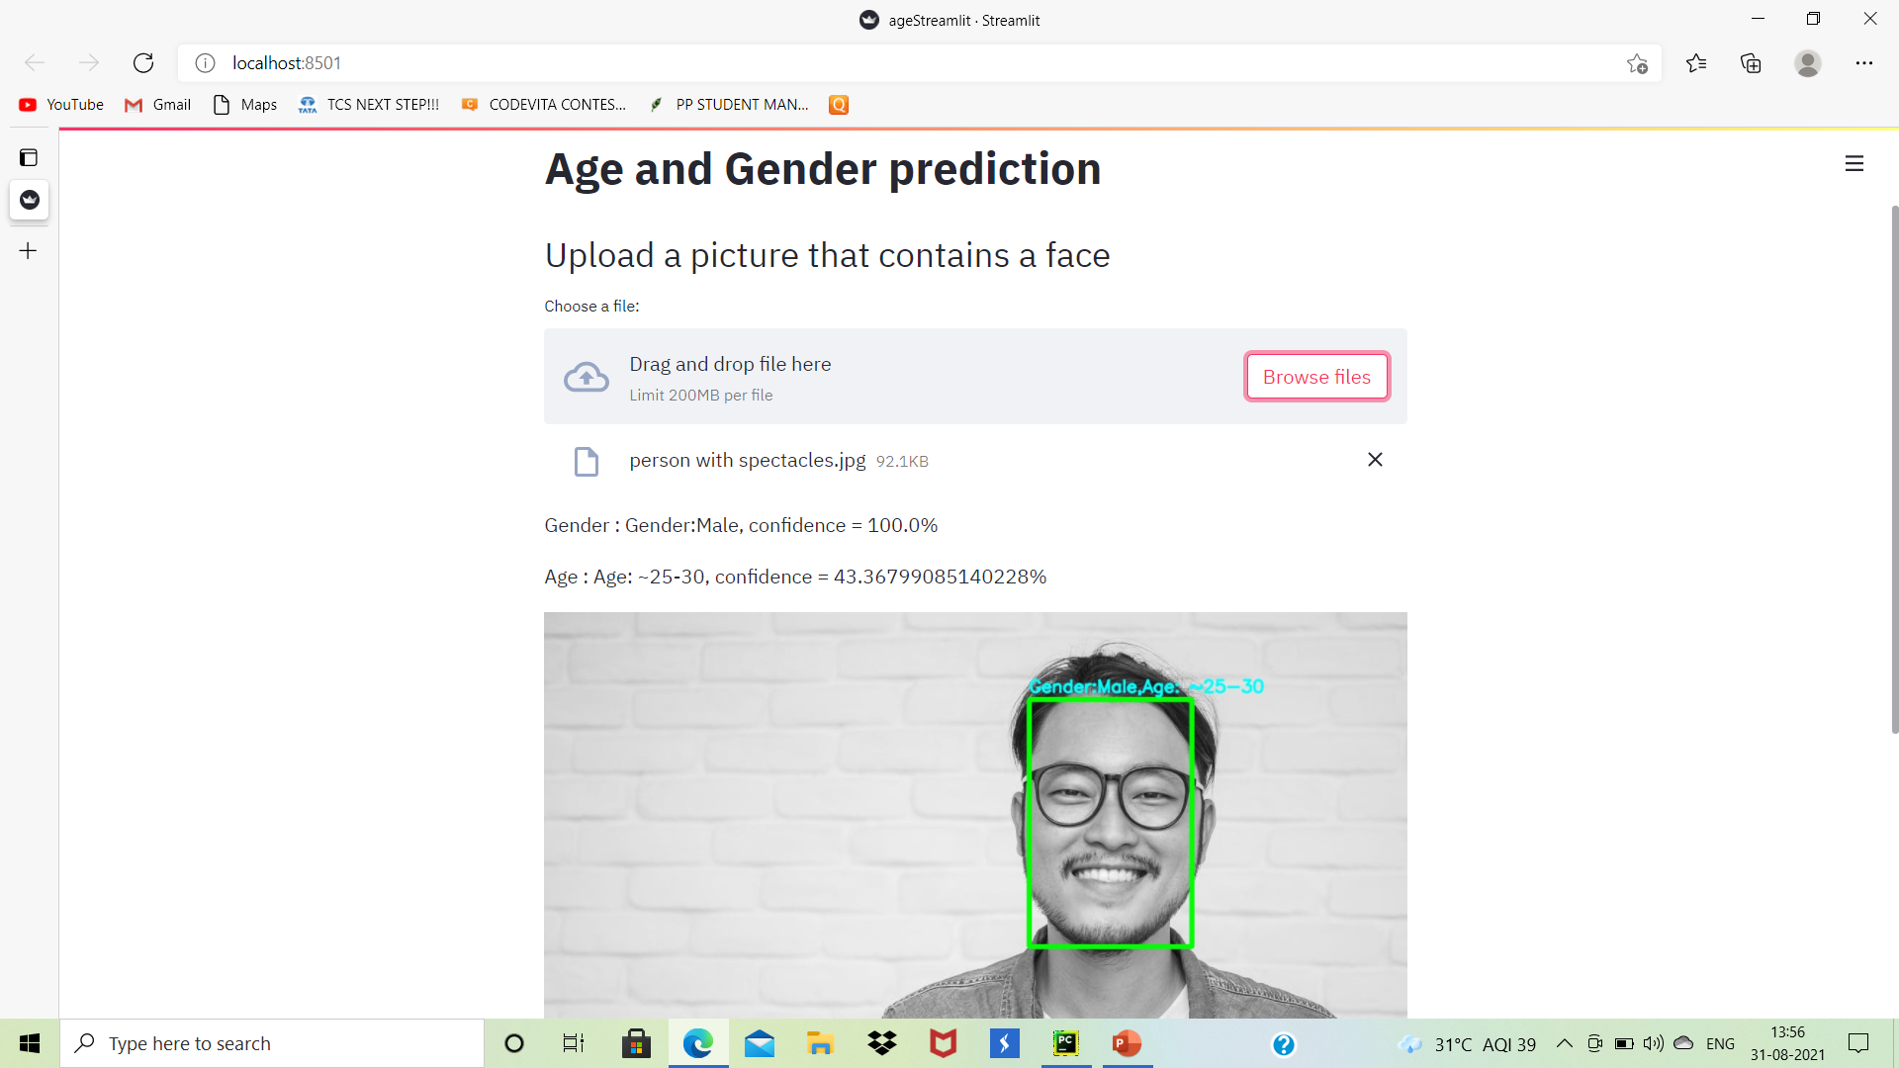
SCREENSHOTS

Slide 17
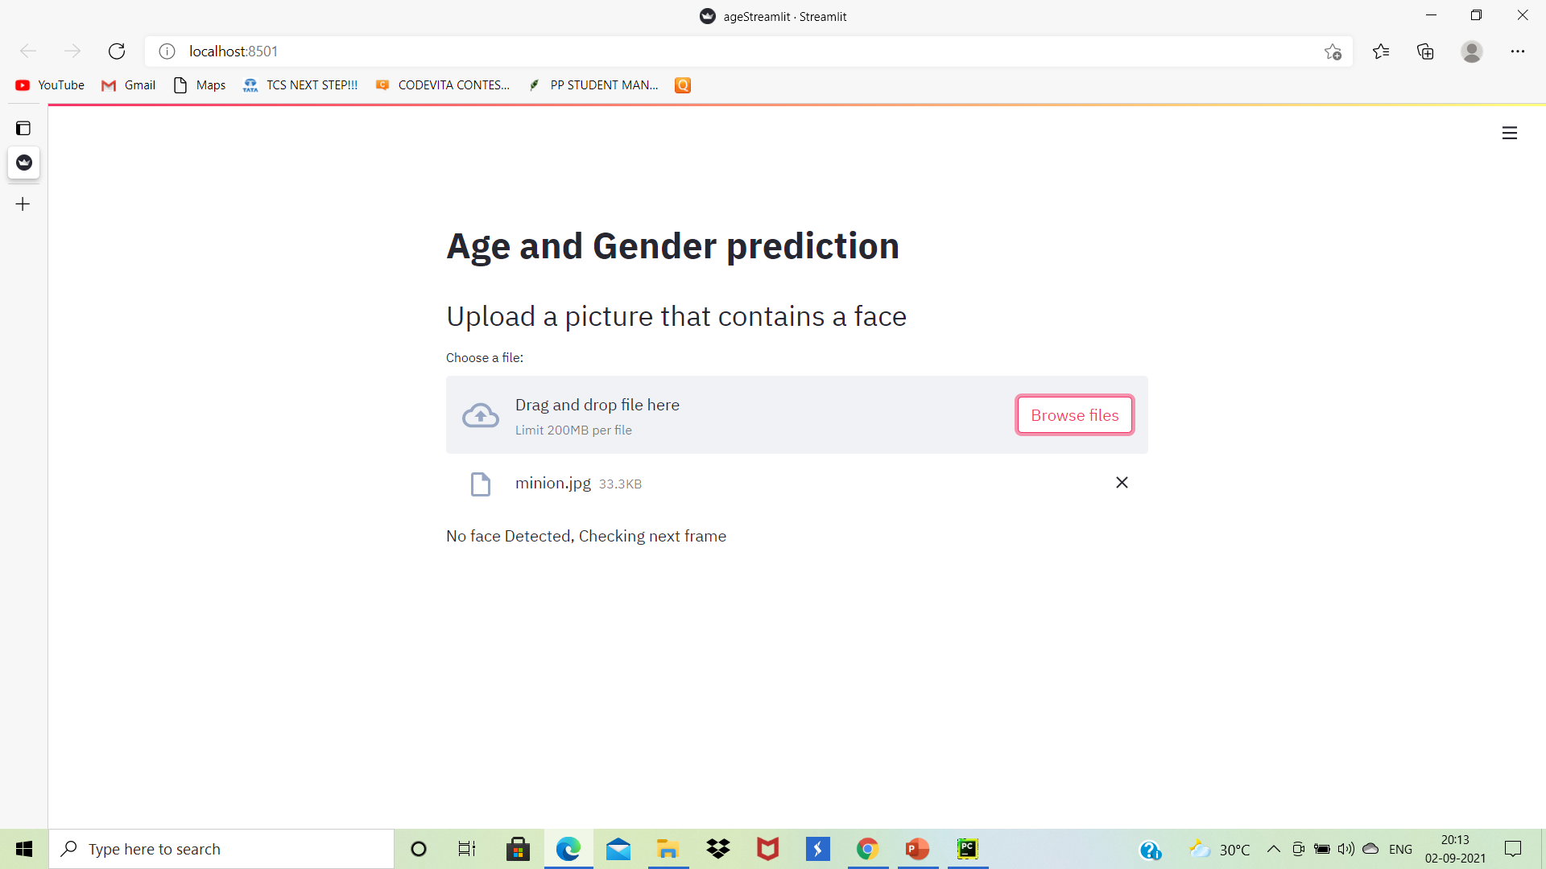

Slide 18
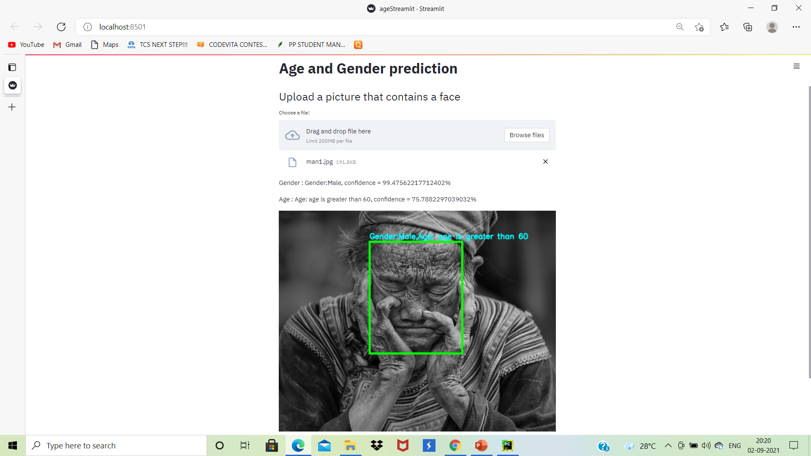

Slide 19
CONCLUSION
We tackled the classification of age group and gender of unfiltered real-world face images.
Our proposed model is originally pretrained on age and gender, whose images are obtained directly from the website with some degree of variability and then fine-tuned.
Our proposed method achieves the excellent performance, in both age group and gender classification.

Slide 20
REFERENCES
https://www.researchgate.net/publication/341431752_Gender_Classification_and_Age_Estimation_using_Neural_Networks_A_Survey
https://iopscience.iop.org/article/10.1088/1757-899X/928/3/032039

Slide 21


